Slide 1
19I720-PROJECT PHASE-1
FINAL REVIEW
ZERO-DAY ATTACK DETECTION AND PREVENTION
FACULTY GUIDE:
Ms. Padmashani R
Assistant Professor [Sl.Gr.]
Department of Information Technology
PSG College of Technology
TEAM MEMBERS:
Jemi Wilson P - 22i227
Keerti N - 22i229
Nandhini I - 22i235
Shahnaz SM - 22i254

Slide 2
AGENDA
Problem Statement
Abstract
Literature Survey
Workflow
Dataset Description
Proposed Methodology
Requirements
Timeline chart
References

Slide 3
PROBLEM STATEMENT
Traditional Intrusion Detection Systems (IDS) fail to detect zero-day attacks as they rely on known attack signatures.
Zero-day attacks pose a major threat to network security due to their unpredictable and evolving nature.
There is a need for detection techniques that can identify abnormal behavior without prior knowledge.
A combined system for real-time detection and active prevention is essential to strengthen cybersecurity against unknown threats.

Slide 4
ABSTRACT
The project aims to develop an intrusion detection and prevention system for detecting both known and zero-day cyberattacks.
Deep autoencoder (DAE) and Causal Recurrent Network (CRN) models are trained on normal network traffic—one for structural events and one for temporal events—to learn standard behavior patterns.
The outputs from these expert models are fused, and high-anomaly events are further processed to classify known attacks using a supervised multi-class model, providing interpretable attack types while unknown events are flagged as zero-day threats.
For deployment, a master–client architecture is implemented: the client systems perform real-time monitoring and send extracted traffic features to the master system.
The master system analyzes these inputs using the trained model, and when suspicious packets are detected, it enforces prevention actions such as blocking or isolating the source.
This setup enables centralized detection and control, ensuring scalable, efficient, and adaptive protection against zero-day threats.

Slide 5
LITERATURE SURVEY
S.NO | TITLE | REFERENCE | INFERENCE | ML/DL MODEL | DRAWBACKS
1 | Detection of Zero-Day Attacks in Computer Networks Using Combined Classification | Concurrency and Computation: Practice and Experience (Wiley), 2022 | Achieves higher detection accuracy by fusing multiple classifiers. | Ensemble/combined classification. | Computationally expensive; model complexity makes deployment harder.
2 | From Zero-Shot Machine Learning to Zero-Day Attack Detection | Int. Journal of Information Security (Springer), 2023 | Detects zero-day attacks by transferring knowledge from known classes. | Zero-shot learning (ZSL). | Relies heavily on semantic mapping; accuracy drops for highly novel attacks.
3 | An Unsupervised Approach for the Detection of Zero-Day Attacks | IET Networks (Wiley/IET), 2024 | Detects unseen intrusions without prior attack signatures. | Unsupervised intrusion detection (clustering or autoencoder). | High false alarm rate due to lack of labels.

Slide 6
LITERATURE SURVEY
S.NO | TITLE | REFERENCE | INFERENCE | ML/DL MODEL | DRAWBACKS
4 | Anomaly Detection Based on CNN and Regularization Techniques Against Zero-Day Attacks | IEEE Access, 2022 | Improves IoT zero-day detection compared to traditional ML. | CNN with L1/L2 regularization. | Computationally heavy for IoT; limited transferability to other domains.
5 | Detecting Zero-Day Malware Using Machine Learning Under Cuckoo | Security and Communication Networks (Wiley–Hindawi),2022 | Sandbox environment boosts malware zero-day detection. | ML classifiers on sandbox-generated features. | Sandbox analysis is resource-intensive and slower for large-scale traffic.
6 | Detecting Zero-Day Intrusion Attacks Using Semi Supervised Machine Learning Approaches | IEEE Access, 2022 | Detects zero-day intrusions with minimal labels. | Semi-supervised ML (clustering + classification). | High false positives when traffic is noisy.

Slide 7
LITERATURE SURVEY
S.NO | TITLE | REFERENCE | INFERENCE | ML/DL MODEL | DRAWBACKS
7 | Analysis of Zero Day Attack Detection Using MLP and XAI | Advanced Computing Techniques, (Springer), 2025 | Provides interpretable decision-making for zero-day detection | Multilayer Perceptron (MLP) + Explainable AI (XAI). | MLP alone may not capture complex traffic patterns; limited scalability.
8 | Explainable AI for Zero-Day Attack Detection in IoT Networks Using Attention Fusion Model | Discover Internet of Things (Springer), 2025 | Combines multiple input views with attention to improve IoT zero-day attack detection, while providing interpretability of decisions. | Attention-fusion deep learning model + Explainable AI (XAI). | Attention mechanisms still computationally heavy for IoT devices; interpretability may not always be intuitive.
9 | Zero-day attack detection using ensemble/ un-supervised algorithms. | IEEE Access(2021) | Ensemble of unsupervised models effective in detecting unknown threats in web/IoT contexts. | Ensemble + unsupervised methods (Isolation Forest, clustering, etc.) | Generic ensemble – model comparisons limited; false positives not fully addressed

Slide 8
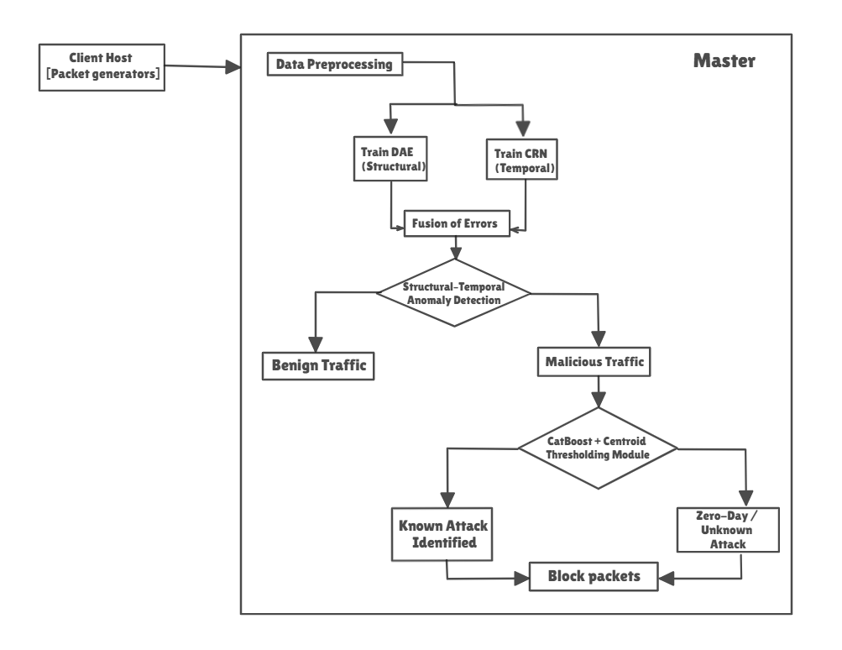
WORKFLOW

Slide 9
HOW THE COMPONENTS WORK TOGETHER TO DETECT
ZERO DAY/KNOWN ATTACKS
DAE gives anomaly signal → CRN encodes temporal context.
Fused score and causal threshold to differentiate normal and attack packets.
Centroid distances flag zero-day clusters → CatBoost classifies known ones.
Combined decision (reconstruction error + centroid distance + confidence) improves accuracy & reduces false positives.

Slide 10
DATASETS USED
Cic-IDS 2017: Contains realistic network traffic with both benign and multiple attack types for intrusion detection research. Includes detailed flow-based features (e.g., packet sizes, duration, protocols)
https://www.kaggle.com/datasets/chethuhn/network-intrusion-dataset
UGRansome Dataset: Focused on ransomware and malware traffic in network environments. Contains labeled families, threats, and predictions, helping classify and analyze malicious behavior.
https://www.kaggle.com/datasets/nkongolo/ugransome-dataset

Slide 11
MODULE 1 - Data Preparation//Preprocessing
PROPOSED METHODOLOGY
Dataset Formation:A hybrid dataset was created by combining publicly available UGRansome attack records with Wireshark-captured real network traffic, resulting in a dataset of shape (1,87,587 × 14). This dataset contains both normal and malicious traffic samples across multiple threat categories.
Preprocessing Steps:
    Data Cleaning
    Categorical Encoding
    Data Validation
Dataset Splitting and Balancing: The cleaned dataset was then divided into normal and attack subsets

Slide 12
Preprocessing: Dataset balancing
Problem: The dataset created showed high skewness i.e some threat classes (like Botnet or DoS) had thousands of samples, while others (like UDP Scan or SSH attacks) were underrepresented.
Approach:
A GAN (Generative Adversarial Network) was trained to generate synthetic samples for minority threat classes.
The Generator learns to create realistic network traffic patterns,
while the Discriminator distinguishes between real and synthetic data.
Outcome:
Achieved a balanced distribution across all threat categories in the Threats column.

Slide 13
Preprocessing: Analysis
Full Dataset | (187587 , 14)
 | (19595, 14)
 | (149043 , 14)
Before Balancing | Shape = (149043 , 14)
After GAN Balancing | Shape = (222534 , 14)
Normal Traffic
Attack Traffic

Slide 14
MODULE 2 - Model Development
Deep Autoencoder for Feature Extraction & Reconstruction
Purpose:
Compress and reconstruct normal network traffic.
Identify anomalies using high reconstruction errors.
Key Functions:
Encoder → learns compressed latent representation of traffic features.
Decoder → reconstructs input data from latent vector.
Trained using MSE loss with early stopping for stability.
Why Chosen:
Captures complex data relationships.
Detects zero-day attacks based on reconstruction deviations.
Creates a compact latent vector (Z) for CRN’s temporal modeling.

Slide 15
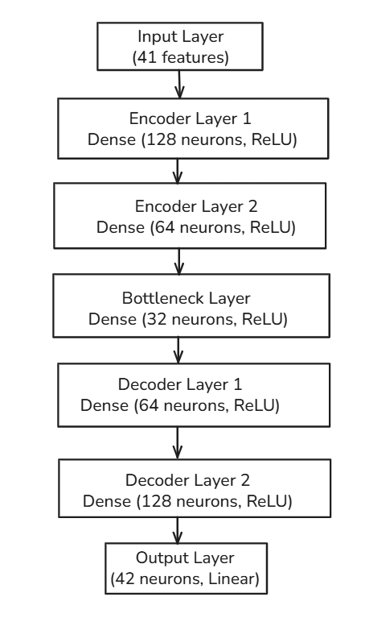
DAE Block diagram

Slide 16
Implementation: Pseudo code
FUNCTION SimpleDAE(input_dim, latent_dim = 64):
Step 1: Create an input layer of size 'input_dim'
Step 2: Build encoder:
- Dense layer with max(64, latent_dim*4) units, ReLU.
- Dense layer with latent_dim units → gives compressed latent representation.
Step 3: Build decoder:
- Dense layer with max(64, latent_dim*4) units, ReLU.
- Dense layer with input_dim units → reconstructs input features.
Step 4: Define models:
- DAE model: input → encoder → decoder → output reconstruction.
- Encoder model: input → encoder → latent representation.
Step 5: Define optimizer as Adam (lr=0.001) and MSE loss.
Step 6: Train autoencoder:
- Split dataset into train (90%) and validation (10%)
- For each epoch:
a. Forward pass → compute reconstruction loss
b. Backpropagate → update weights
c. Check validation loss for early stopping (patience = 30)
d. Save best model when validation loss improves
- Stop training if validation loss does not improve for 'patience' epochs
Step 7: Load best model weights.
END FUNCTION

Slide 17
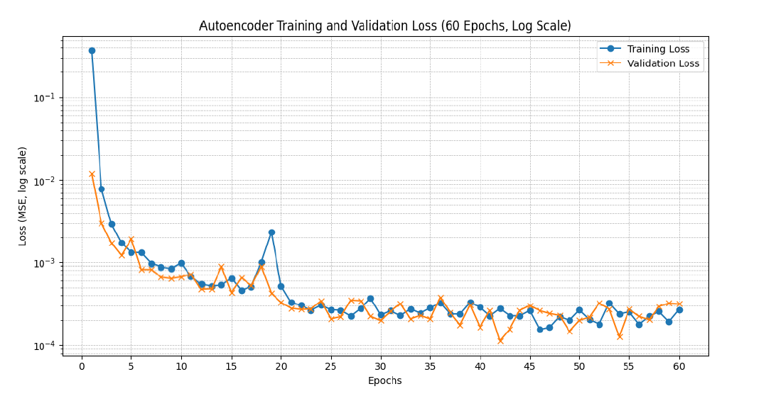
DAE Evaluation

Slide 18

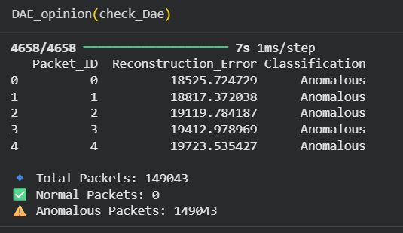
DAE Evaluation

Slide 19
Causal Recurrent Network (CRN)
Purpose:
Model temporal dependencies in traffic patterns.
Detect anomalies through prediction deviation.
Key Functions:
Learns sequence patterns of latent vectors from DAE.
Predicts future behavior and measures prediction error (MSE).
Early stopping ensures optimal learning without overfitting.
Why Chosen:
Handles time-dependent traffic data efficiently.
Detects context-aware anomalies missed by static models.
When combined with DAE, it provides dual anomaly signals — reconstruction + prediction errors.

Slide 20
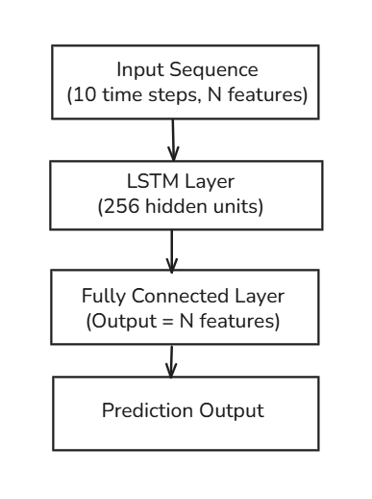
CRN Block diagram

Slide 21
Implementation: Pseudo code
FUNCTION CRN(latent_dim, hidden_units = 256, n_layers = 1, window_size = T):
Step 1: Prepare input windows:
- Use Z_all (latent features from DAE)
- Create sliding windows of length 'window_size' → Xw
- Next step prediction → Yw
Step 2: Keep only normal/benign windows for training
Step 3: Define LSTM-based CRN model:
- LSTM layer with 'hidden_units' and 'n_layers'
- Fully connected (linear) layer from hidden_units → latent_dim
Step 4: Split dataset into train (90%) and validation (10%)
Step 5: Define optimizer and loss:
- Optimizer: Adam (lr = 0.001)
- Loss function: MSELoss
Step 6: Train model with Early Stopping (patience = 10):
a. Forward pass → predict next latent vector
b. Compute prediction loss
c. Backpropagate → update weights
d. Evaluate validation loss
e. Save best model if validation loss improves
f. Stop training if no improvement for 'patience' epochs
Step 7: Load best model weights
END FUNCTION

Slide 22
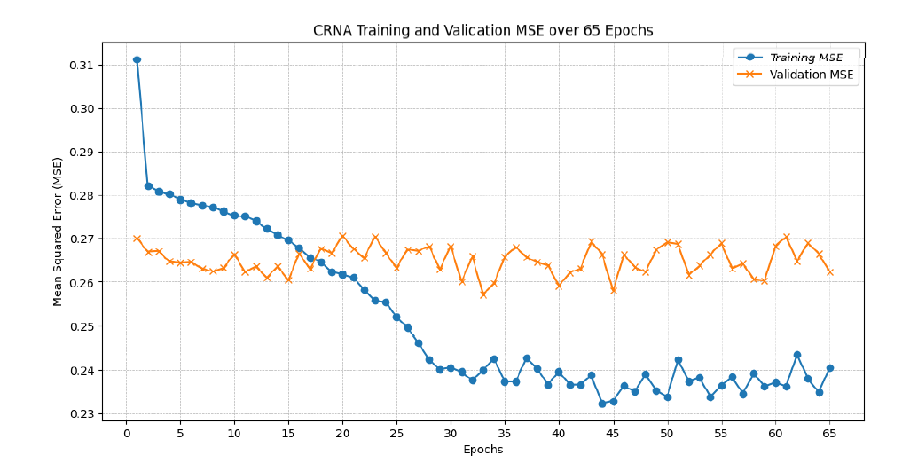
CRN Evaluation

Slide 23

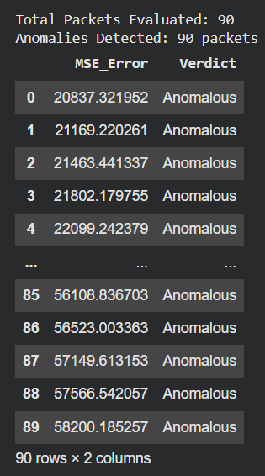
CRN Evaluation

Slide 24
MODULE 3 - Anomaly Scoring & Adaptive Thresholding
Prediction Error (CRN) – Measures temporal deviations in latent space using L2 norm between predicted and actual latent vectors.
Reconstruction Error (DAE) – Captures feature-level anomalies by comparing original and reconstructed samples.
Score Fusion – Normalizes and combines both errors to produce a single anomaly score per sample.
Adaptive Thresholding – Computes a dynamic, moving-window threshold to detect anomalies in a causal manner.
Alarm Generation – Flags anomalies exceeding the threshold .

Slide 25
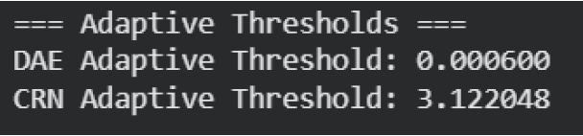
Adaptive Threshold Result

Slide 26
MODULE 4 - Classifier - Known & Zero day attacks detection
Prepare Attack Labels: Threats column is taken to form attack labels.
Train CatBoost Classifier:Train CatBoost on balanced attack classes to classify the type of attack.
Compute Class Centroids & Thresholds: For each attack class, calculate the centroid and 95th percentile distance to define known vs zero-day boundaries.
Normal vs Attack Detection using Fused Score: Combine DAE reconstruction error and CRN prediction error into a fused anomaly score; apply an adaptive threshold to detect attacks.
Sample Packet Classification: For selected packets, check if normal or attack; if attack, classify type and determine known vs zero-day using centroid distance.

Slide 27
CatBoost
Purpose:
Predicts categories or numbers from structured data (like tables).
Works really well with datasets that have categorical features (like “protocol type” or “service”).
Key Functions:
Builds decision trees step by step to reduce errors, using a special method called ordered boosting to avoid overfitting.
Automatically converts categorical data into a usable form without manual encoding.
Uses regularization and early stopping to prevent overfitting.
Why Chosen:
Ideal for network traffic data, where many features are categorical.
Needs less manual tuning compared to XGBoost or LightGBM.
Probability outputs can be effectively fused with anomaly scores for zero-day attack detection, improving the robustness of classification models in cybersecurity pipelines.

Slide 28
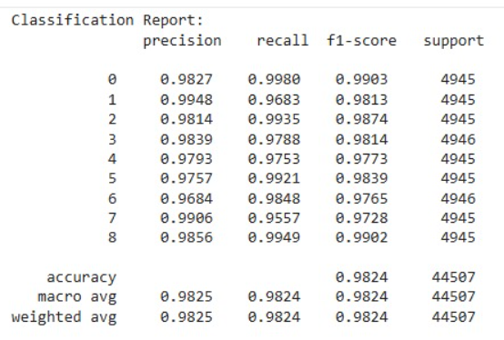
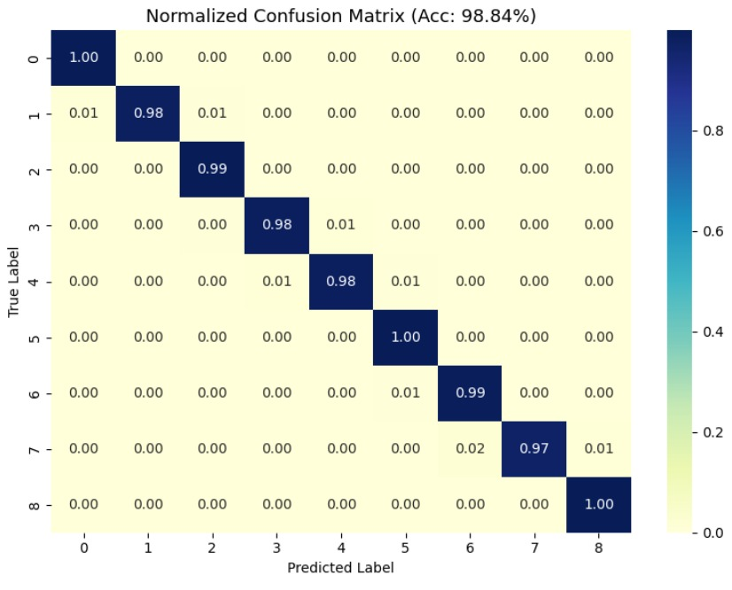
CatBoost Evaluation

Slide 29
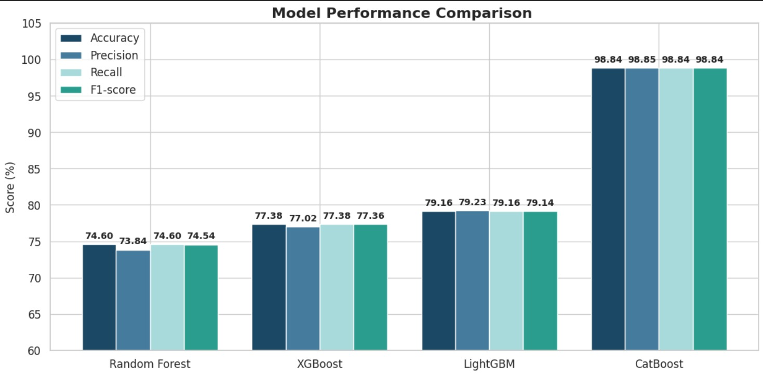
Model Performance Comparison

Slide 30
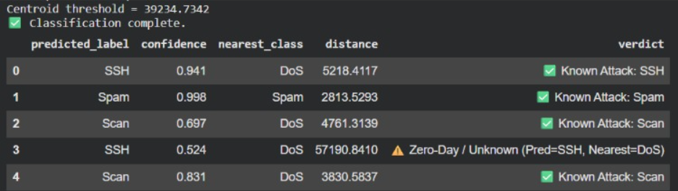
Classification Results

Slide 31
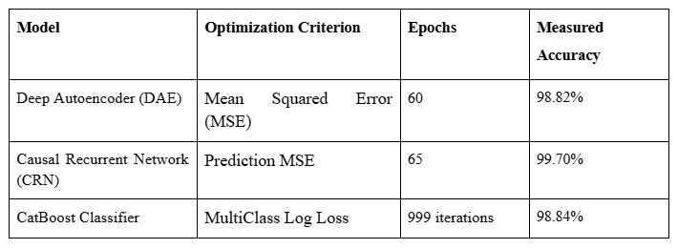
Model Training Metrics

Slide 32
MODULE 5 - Client-Master Deployment
Centralized Monitoring: Deploy the trained ML model on a central “master” system responsible for analyzing data.
Client Configuration: Each client system collects its own logs or network data and sends it to the master for processing.
Communication Protocol: Use socket programming or lightweight APIs (e.g., Flask) for real-time data transfer between clients and master.
Scalability: Easily expandable architecture — more clients can be added with minimal changes to the master logic.

Slide 33
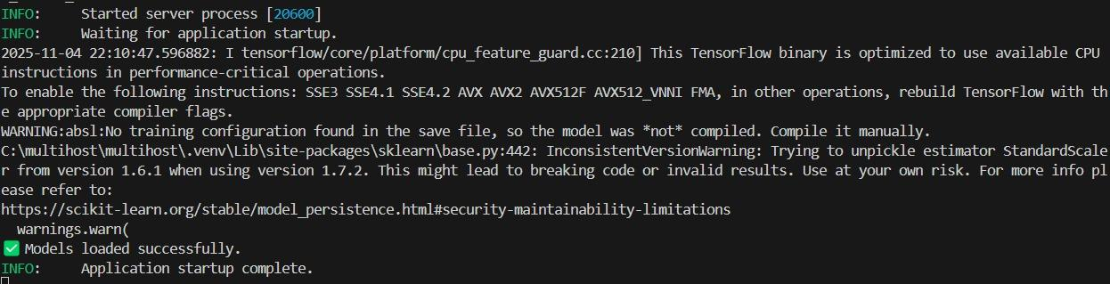
MODULE 5 - Client-Master Deployment
Server setup using FastAPI

Slide 34
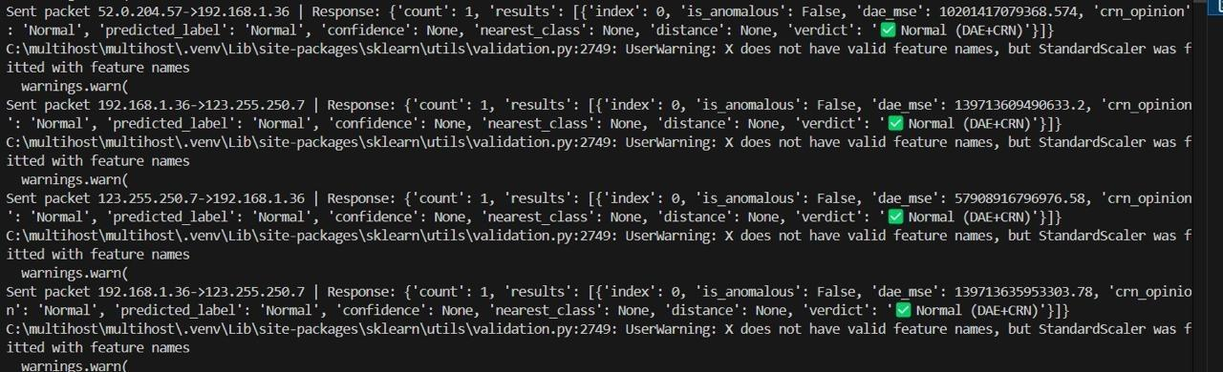
MODULE 5 - Client-Master Deployment
Clients : Packet transmission log showing anomaly detection and classification results

Slide 35
SOFTWARE REQUIREMENTS:
Operating System: Ubuntu 20.04 LTS / Windows 10 or later
Programming Language:
Python 3.8 or above
Libraries/Frameworks:
TensorFlow 2.x or PyTorch (for Deep Autoencoder)
Scikit-learn (for preprocessing, evaluation)
Pandas, NumPy (for data manipulation)
Flask (for API communication between client and master)
Jupyter Notebook (for development/testing)
Traffic Monitoring Tools:
Wireshark (for packet capture on clients)

Slide 36
HARDWARE REQUIREMENTS:
Master System:
Processor: Intel Core i5/i7 or AMD Ryzen 5 (or better)
RAM: Minimum 8 GB (16 GB recommended for real-time processing)
Storage: SSD with at least 50 GB free (logs, datasets, environment)
Network: Ethernet/Wi-Fi (LAN recommended for faster log transfer)
Client Systems (2 nodes):
Processor: Intel Core i3 or equivalent
RAM: 4 GB minimum
Storage: 20 GB (for log generation and transmission)
Network: Basic connectivity to send logs to master via socket/HTTP

Slide 37
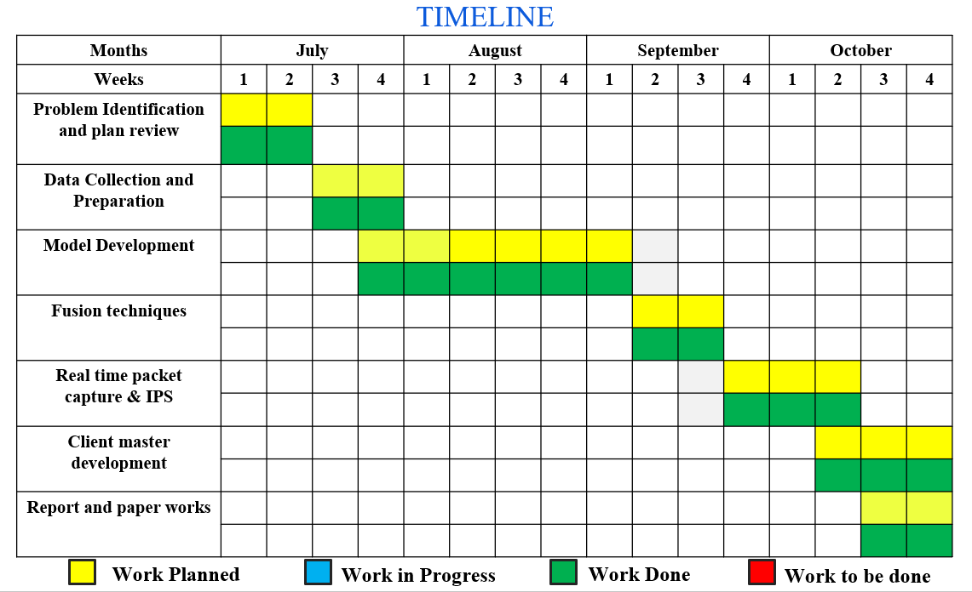

TIMELINE CHART

Slide 38
REFERENCES
H. Xu, Y. Wang, and Y. Yu,“Anomaly Detection in Network Traffic Based on Deep Autoencoder,” IEEE Access, vol. 7, pp. 137422–137429, 2019.: https://arxiv.org/abs/1802.09572
S. Olugbenga, M. A. O. Binbusayyis, and M. S. Mahmud, “Machine Learning Approaches for Detection of Zero-Day Attacks: A Review,” EEE Access, vol. 9, pp. 16846–16867, 2021: https://ieeexplore.ieee.org/document/9448992
S. Sheikhalishahi, M. H. Yaghmaee, and M. Fathy, “A Real-Time Anomaly Detection System for IoT using Deep Autoencoder,”Journal of Network and Computer Applications, vol. 170, p. 102767, 2020.: https://doi.org/10.1016/j.jnca.2020.102767
T. M. T. Nguyen and G. Armitage,“A Survey of Techniques for Internet Traffic Classification using Machine Learning,”IEEE Communications Surveys & Tutorials, vol. 10, no. 4, pp. 56–76, 2008.: https://doi.org/10.1109/SURV.2008.080406
M. Sarhan, S. Layeghy, M. Gallagher, and M. Portmann,“From Zero‑Shot Machine Learning to Zero‑Day Attack Detection,”International Journal of Information Security, vol. 22, pp. 947–959, 2023: https://doi.org/10.1007/s10207-023-00676-0
H. Hindy, R. Atkinson, C. Tachtatzis, J.-N. Colin, E. Bayne, and X. Bellekens,“Utilising Deep Learning Techniques for Effective Zero‑Day Attack Detection,”Electronics, vol. 9, no. 10, p. 1684, 2020.https://doi.org/10.3390/electronics9101684

Slide 39
Y. Guo “A Review of Machine Learning-Based Zero-Day Attack Detection: Challenges and Future Directions,”Computer Communications, vol. 198, pp. 175–185, 2023: https://doi.org/10.1016/j.comcom.2022.11.00
S. Oluwadare and Z. ElSayed,“A Survey of Unsupervised Learning Algorithms for Zero-Day Attacks in Intrusion Detection Systems,”FLAIRS Conference Proceedings, vol. 36, 2023: https://doi.org/10.32473/flairs.36.133182
A. Dahal, P. Bajgai, and N. Rahimi,“Analysis of Zero Day Attack Detection Using MLP and XAI,”in Communications in Computer and Information Science, vol. 2254, 2025. https://doi.org/10.1007/978-3-031-86637-1_5
Q. Zhou and D. Pezaros,“Evaluation of Machine Learning Classifiers for Zero-Day Intrusion Detection—An Analysis on CIC-AWS-2018 Dataset,”arXiv preprint, 2019.https://arxiv.org/abs/1905.03685
T.-H. Chua and I. Salam, “Evaluation of Machine Learning Algorithms in Network-Based Intrusion Detection System,arXiv preprint, 2022:https://arxiv.org/abs/2203.05232
M. Ozay, I. Esnaola, F. T. Yarman-Vural, S. R. Kulkarni, and H. V. Poor,“Machine Learning Methods for Attack Detection in the Smart Grid,”arXiv preprint, 2015: https://arxiv.org/abs/1503.06468

Slide 40
THANK YOU

